Slide 1
About this presentation
The visiting team chair presentation template has been designed to either be presented in its entirety or broken out. The visiting team chair will determine how many pre-visit meetings will take place and what content will be covered in each meeting. A suggested breakdown follows:
Slides 1 – 74 during an introductory team web meeting;
Slides 74-81 during a second team web meeting;
A recap of slides 35-73 plus slides 82-87 and during the final meeting of the visiting team, at the first meeting of the team during the visit itself.
The intent of this presentation is to deliver consistent training of program visitors by visiting team chairs.
Programs receiving visits may be interested in reviewing this presentation for their own information or for sharing with their faculty and staff who are involved in the visit.
This presentation is updated annually to reflect ongoing improvements to the accreditation criteria, policies, and procedures.

Slide 2
Accreditation Visit to <name of HEI> <date range>
Name of Presenter
Title

Slide 3
Outline
HEI Background
Accreditation and the CEAB
Roles and responsibilities
Leading up to the visit
The criteria
Recent relevant changes
The visit
The report

Slide 4
Higher Education Institution (HEI) Background
History and current situation
<when HEI opened>
<current student complement>
<any major contextual factors>
Purpose of this visit
<list programs being visited>
<indicate when these programs were most recently visited and what the CEAB decisions was>
Notes:
More information related to this slide
Information shown on this slide is a summary. Full information about the institution and the program being visited is developed by the institution and supplied to team members 8 weeks in advance of the visit, in the “Questionnaire”.

Slide 5
Visit format 2020 / 2021
All visits are being conducted virtually.
The term on-site visit and virtual visit may be used interchangeably throughout this presentation.

Slide 6
Accreditation and the CEAB

Slide 7
The Accreditation Board
Established in
1965
Accredits undergraduate engineering educational programs
Volunteer members are
20 P.Eng./ing.
Deans, former deans, senior faculty members, and industry representatives
Most members from academia have also worked in industry
30% of members are women, 45% of members are bilingual
Notes:
At July, 2019

Slide 8
Goals of the Accreditation Board
Engineering programs offered by Canadian institutions will meet or exceed minimum educational standards acceptable for professional engineering licensure in Canada.
The quality and relevance of engineering education will continuously improve.
The Engineers Canada Board of Directors will be provided with advice and recommendations on international matters relating to engineering education and accreditation.

Slide 9
What does the Accreditation Board do?
Paper review
Visit
Report
CEAB
accreditation decision
The visiting team
Program information gathering and review
Visiting team not responsible for accreditation decisions
Notes:
Some have compared the process to an “audit”:
Teams of experts review program information, both on paper and on-site.
They gather information about the programs in a visit report.
The team tri-angulates evidence from the Questionnaire, on-site interviews, on-site documentation review.
This report, plus any additional relevant information, as well as the Board’s collective experience is used to produce accreditation decisions.

Slide 10
CEAB Accreditation: General notes
Accreditation:
Applies only to programs (not to departments or faculties)
Is undertaken only at the invitation of the HEI and with the consent of the appropriate regulator
Constitutes:
Quantitative and qualitative evaluation of the curriculum
Qualitative evaluation of the program environment
Is granted for a period of time up to and not exceeding six years

Slide 11
How do we do it? The accreditation process:
1
Request for accreditation
HEI submits RFA
HEI completes Questionnaire
1
2
Build the visit team
Visit Chair assigned and team selected
HEI approves visiting team
Preparatory teleconferences
Visit date selected
8
2
8
CEAB decision
Visit dossier prepared for CEAB meeting
Accreditation decision
Communication of decision
3
Questionnaire
HEI completes and submits Questionnaire 8 weeks prior to visit
Build visit schedule
7
18 MONTHS
3
7
Visit report
CEAB editor reviews report for consistency
Report sent to HEI dean
HEI dean check for accuracy and completeness
4
Program materials
HEI makes program/course materials available during site visit
6
4
6
5
Write report
Visitors prepare tracking of issues
Chair compiles visiting team report
5
Reporting
Interviews and observations
Data collection
2.5-day site visit
Holds interviews according to schedule
Notes:
At all stages: ongoing communication between the Dean/Designated Official and the Team Chair.

Slide 12
Accreditation and continual improvement
Program
outcomes evaluated
Changes planned (curriculum, courses, performance metrics, etc.)
Changes implemented
Data
collection
and
evaluation
Accreditation is based on a snapshot in time of a given program
The accreditation process has a definitive start and end
HEIs must continue to continually improve for the duration of their accreditation period
Plan. Do. Check. Act

Slide 13
Accreditation activities
284
accredited programs
43
HEIs in Canada
5
Substantially equivalent programs
1
HEIs outside of Canada

Slide 14
Resolution of issues
June decision meetings
 | 2018 | 2019 | 2020
# of programs | 64 | 69 | 52
# of issues identified | 169 | 344 | 325
Issues resolved* | 90 (53%) | 264 (77%) | 60 (18%)
Issues unresolved | 79 (47%) | 80 (23%) | 265 (82%)
* as a result of deans’ response
Notes:
The accreditation visit is a fact-finding process. The number of issues identified are done so through the review of the questionnaire materials and through what is observed during the site visit.
Context for 2020 numbers:
GA/CI criteria were applied to many programs for the first time. Therefore, it’s the first time the HEI is presenting their GA/CI information and the first time that they are assessed. Meanwhile, the CEAB is well into the evaluation of the GA/CI criteria so they are practiced. Many of the resolved issues were related to GAs which may indicate that the HEI did not present all of the information with their Questionnaire that would demonstrate compliance, the visiting team missed or misinterpreted the information as presented, or the program made changes between the visit and the report. More likely a balance of the first two explanations than the second.

Slide 15
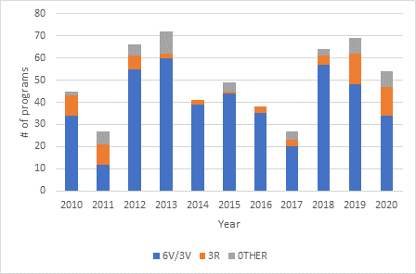
CEAB visit decisions 2010-2020
Notes:
At July 2019
3V is typically the max given to a new program (in 2019 there were two new programs); (3Vs can be given to programs with findings that are not reportable)
6 years is the longest an accredited program can go without a visit.
“Other” includes (2V, FV, 1V, etc. Could be to align accreditation visit schedules for multiple programs at one HEI. Multitude of reasons for “other”)

Slide 16
Roles and responsibilities

Slide 17
Objectives of the visiting team
Conduct fact-finding on behalf of the Accreditation Board
Review, validate and/or add to the information provided by the HEI
Examine submitted materials (the questionnaire and on-site), meet with program officials, the facilities
Corroborate program strengths and weaknesses
Triangulate evidence
Collaborate to prepare a report of the visiting team’s findings
To bring forward issues to the CEAB
The visiting team does not make any recommendations.
Accreditation decisions are made by the CEAB.
Notes:
This list of objectives of the visiting Team is provided in more detail in the “Accreditation Criteria and Procedures 2018”, including the list of accreditation criteria grouped in the following categories:
Continuous Improvement
Graduate Attributes
Students
Curriculum Content
Program Environment
The template for the final report, the deliverable from the Visit, is “Visiting Team Report Template”. Each Program Visitor will complete their own report (or a consensus report when a program has more than one Visitor). Observations by General Visitor, Vice-Chair and Chair will be integrated into the Program Visitors’ reports as well as forming the prefatory and concluding material of the report. In addition, the General Visitor will prepare a report to the engineering regulators/organisme(s) de réglementation having jurisdiction, documenting the process of the visit, using “General Visitor Report to the provincial and territorial engineering regulators ” as a template.

Slide 18
The visiting team: Key Roles
Team Chair
Program Visitor(s)
Vice Chair
Observer(s)
General Visitor
CEAB Secretariat

Slide 19
Team and Vice- Chair Key Roles
CEAB member (or past member)
Has overall responsibility for the visit
Prepares and submits the Report of the Visiting Team to the CEAB
Team Chair
Assists the team chair
Evaluates program common core
Evaluates criteria related to graduate attributes and continual improvement
Vice-Chair(s)

Slide 20
General and Program Visitors Key Roles
One or two per visit
Appointed by the provincial regulator
Evaluates occupational health and safety aspects of the curriculum (safety, student projects, support departments and facilities)
Reports findings to the regulator
General Visitor(s)
One per program (two for new programs)
Assesses course content, materials, facilities and program stability
Interviews departmental faculty, staff, and students
Program Visitor

Slide 21
Observers and CEAB Secretariat Key Roles
Observes the aspects of the visit which are of the most interest
Washington Accord, Engineers Canada Board, other accrediting agencies in Canada/international, etc.
Observers
Coordinates the visit from start to end (logistics, support Team Chair, visiting team report, etc.)
Attends visits as requested
Identifies potential process improvements
CEAB Secretariat

Slide 22
Time commitments
ACTIVITY | DUE DATE | TIME COMMITMENT
Review of institution questionnaire Preparation of Tracking of program issues: Working document form Training (including the online training module and 1-3 teleconferences with the visiting team) | 2-4 weeks before visit | 1-3 days
On-site visit | (Saturday evening arrival to Tuesday afternoon departure) | 1 travel day + 3 working days
Completion of visiting team report | Submit to team chair within 2 weeks after visit | 1 day

Slide 23
Virtual visits

Slide 24
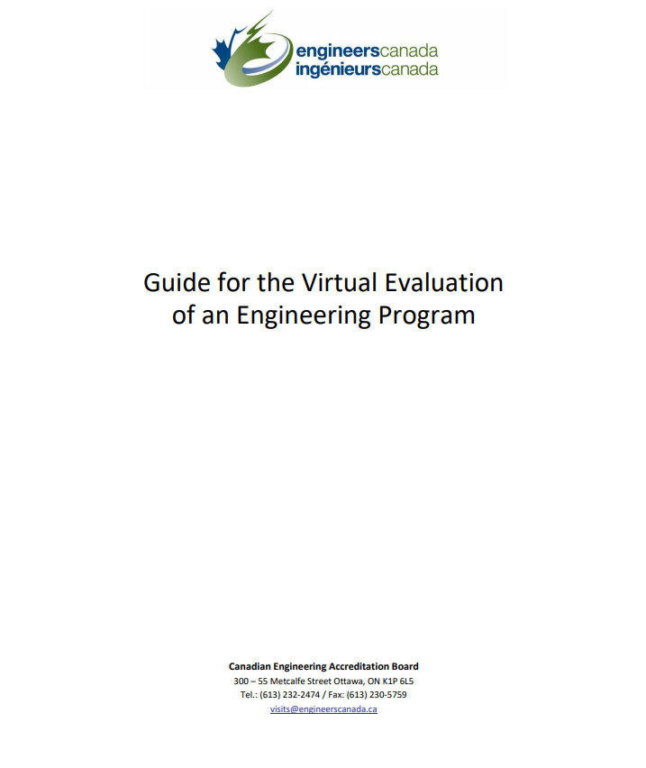
Considerations for the virtual visits
Notes:
Travel restrictions and physical distancing requirements due to the COVID‐19 pandemic requires the 2020/2021 CEAB accreditation visit cycle to adjust. Where the visit would normally take place in‐person, the CEAB has struck a taskforce to develop an approach to virtual accreditation visits. The Guide for the virtual evaluation of an engineering program serves as a starting point to help programs prepare for their review and provides the visiting team the data it requires to complete their evaluation.
The guide has been shared with the institution being visited. The Visiting Team Chair and the Designated Official have been in regular contact to fine-tune the logistical details of the visit.
All visiting team members should read this document.

Slide 25
Some additional considerations for the virtual visit
Confidentiality policy applies regardless of visit format
Recording and screen captures of meetings is not permitted
Visit team members are responsible for the erasure of all visit materials from their computer systems after the June CEAB meeting

Slide 26
Some additional considerations for the virtual visit
Technology considerations
Engineers Canada’s meeting platform will be used for all team meetings
The institution’s meeting platform will be used for meetings with program representatives
Ensure you have:
a secure, wired internet connection
a webcam
a quality headset and mic
All participants in virtual interviews are asked to be flexible and understanding of fellow participants who may be taking the meeting from their home; noise from family and pets may be unavoidable, though participants should make efforts to limit these instances.

Slide 27
Some additional considerations for the virtual visit
More material will be made available (electronically) to the visiting team ahead of the visit, including:
Virtual tours of laboratory spaces, study spaces, club spaces, teaching facilities;
Course material typically distributed to students in each course (course outlines, homework assignments, lab instruction sheets, project instructions, quizzes, exam questions, etc.)
Samples of graded student work, tests, problem sets, examinations, laboratory and design reports, etc.)
Graduate attribute / continual improvement documentation
Safety manuals and procedures

Slide 28
Undergraduate engineering education and the pandemic
Institutions are working hard to maintain the integrity of their program(s) and their adherence to the accreditation criteria in unprecedented times.
For many institutions, the modalities of instruction had to change suddenly during the Winter 2020 semester, forcing the cancellation of labs and, very quickly, the implementation of online delivery for the balance of the term.
For the Spring and Summer 2020 terms, institutions made rapid decisions about program delivery moving course instruction, labs, assignments, etc. online.

Slide 29
Undergraduate engineering education and the pandemic
Some programs gave pass/fail or satisfied/unsatisfied standings (or similar) in some courses where letter or percentage grades would typically be given.
Some cancelled in-person final exams and make other academic accommodations.
Some implemented alternates to field work and lab instruction to achieve specific learning outcomes.

Slide 30
Leading up to the visit

Slide 31
Accreditation criteria and procedures
All visiting team members should:
Become familiar with the criteria
Note the evolution of criteria and interpretive statements
They may have changed since you were last a program visitor!

Slide 32
Training
Online training to be completed by each member of the team
Login details provided by the CEAB Secretariat
Overview of the accreditation process, roles and responsibilities, tips and tricks, etc.

Slide 33
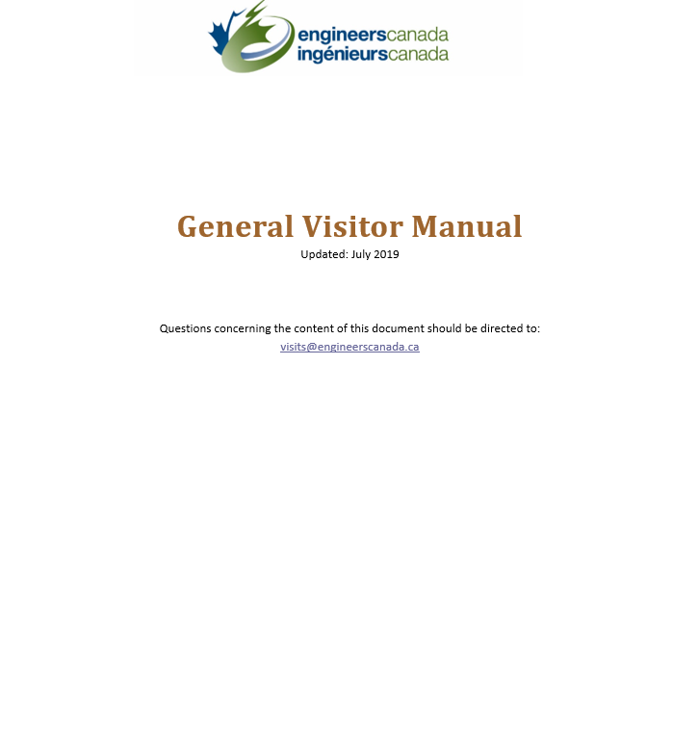
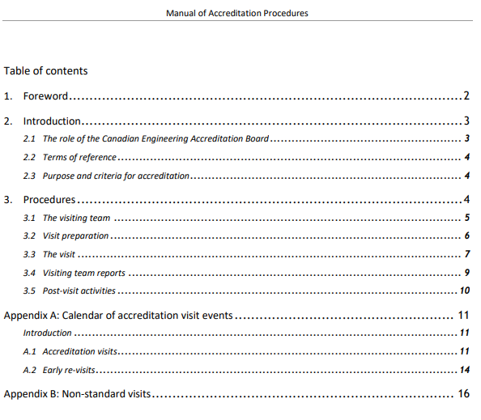
Team resources
www.engineerscanada.ca/accreditation

Slide 34
Team member activities
Comply with Engineers Canada’s Board Code of Conduct.
Attend 2-3 teleconferences organized by the Team Chair
The number and frequency of meetings as needed
Getting to know the team
General overview of process
Identification of issues
Planning visit schedule
Individually review program’s questionnaire
Identify issues for investigation during the visit
Complete the Tracking of program issues: Working document

Slide 35
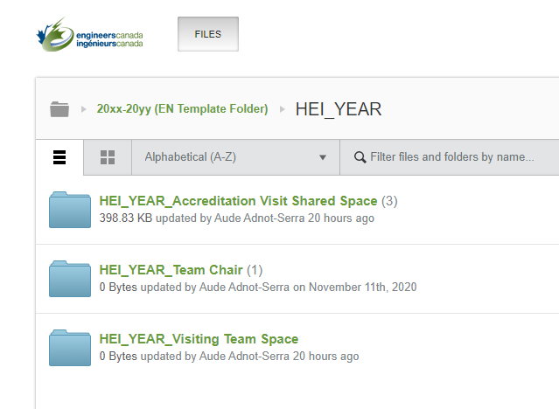
Accessing program materials
Program materials available on the CEAB OneHub site 8 weeks prior to the visit.
The CEAB Secretariat will send an invitation to each team member to access the various applicable files and create their own password if necessary.
Read the materials provided by your assigned program(s).

Slide 36
Tracking of issues
Use this tool to record your findings based on your pre-visit review of the institution’s questionnaire.
The visiting team can use this document to develop the site visit schedule and guide discussions while on-site.
When in doubt, consult with the Chair or Vice Chair.
Notes:
Team Chair will liaise with the Dean/Designated official to identify any issues before the team arrives on-site. This reduces the stress for the HEI and makes the visit more efficient. Sometimes more information will be provided by the program to the visitor, other times these discussions inform the development of the visit schedule. Openess and transparency with the HEI is key.

Slide 37
Identifying issues
The “minimum standard” is established by the criterion
and (if one exists) further explained in the interpretive statement.
Your options (NEW!):
✓ = no observed issue on the criterion. Comments could include how the institution complies with the criterion (for example, innovative methods used to ensure compliance, and/or procedures and policies that deserve special mention).
* = item flagged for CEAB review that, in the opinion of the visitor, has the potential to either jeopardize future compliance or currently prevents compliance with the criterion. Justification is required for * observations.

Slide 38
Writing an observation
For each written observation, follow a three-element format:
cite the applicable language from the criterion, policy, or procedure (with quotation marks) as context for the observation;
describe evidence observed; then
describe the positive or negative impacts to the program.
Written observations for * are required.
Written observations for ✓are welcome.
Notes:
It is required that all visiting team members comply with this format.

Slide 39
Tips
Quantitative criteria are binary observations. Either the criteria have been met or not.
Avoid the terms “concern”, “weakness”, “deficiency” in your written comments
These terms are reserved for CEAB accreditation decisions
The CEAB will discuss your findings at a decision meeting where a decision will be made as to whether the program’s compliance to criteria is acceptable, a concern, a weakness, or a deficiency.

Slide 40
The criteria

Slide 41
Accreditation criteria and procedures
The processes of accreditation place emphasis on the quality of the:
Students
Curriculum
Academic staff/support staff
Facilities and resources
Reminder: The onus is on the HEI to demonstrate compliance with the criteria.

Slide 42
About criteria and interpretive statements
Criteria
Describe the measures used by the Accreditation Board to evaluate Canadian engineering programs for the purpose of accreditation.
Interpretive Statements
Additional guidance on the interpretation and application of specific criteria.

Slide 43
Input and outcomes criteria: Why both?
Input criteria
Outcomes criteria
Prescribed exposure times to essential curriculum elements
Defines graduate attributes
ACCREDITATION DECISION
Enables easy calculation of the minimum path
Regular assessment of graduate attribute attainment drives continuous improvement
Notes:
Why BOTH input and outcomes criteria? For HEIs, they thought that we are going to be evolving from input measurement to outcomes assessment. But regulators like inputs. Retaining both, we think we can cut down on work from institutions. Washington Accord countries were all moving toward it so we needed to move with the trend to remain a member. WA membership is important for mobility of engineering. Regulators want this too (if someone applies for licensure from a WA country, there’s comfort there).
Demonstrate that we are doing both inputs and outcomes assessment which requires a whole lot less input data.
Our bosses are the regulators and they are very comfortable with input assessment. Outcomes has not replaced input. Where we are going, we are looking at process as opposed to results… to save HEIs time from proving to the AB that they are right.

Slide 44
Common issues identified
Program environment
Inadequate lab facilities and insufficient space (3.5.1.2)
Inadequate number of full-time faculty (3.5.2.1)
Long-term leaves and long sabbaticals
Soft-funded faculty
Teaching loads ~ critical dependence on a single individual
Curriculum content and quality
Insufficient introduction to a culture of occupational health and safety (3.4.2)
AU adjustments to:
natural sciences (3.4.3.2)
engineering science (3.4.4.2)
engineering design (3.4.4.5)
Notes:
This is not an exhaustive list.

Slide 45
Criteria highlights: Curriculum content and quality
Measured by “Accreditation Units” (AU)
one hour of lecture (corresponding to 50 minutes of activity) = 1 AU
one hour of laboratory or scheduled tutorial = 0.5 AU
Three ways to measure curriculum:
Traditional classroom and lab instruction measured by AUs (3.4.1.1)
Non-contact hours, i.e. K-factor (3.4.1.3)
Innovative engineering teaching methodologies with compelling rationale (3.4.1.4)
Notes:
Accreditation criteria are described in “Accreditation Criteria and Procedures 20xx”.
Assure the minimum path

Slide 46
Minimum curriculum components
Curriculum component | Minimum AUs
Mathematics | 195
Natural sciences | 195
Mathematics and natural sciences combined | 420
Engineering science | 225
Engineering design instructed by P.Eng./ing. | 225
Engineering science and engineering design combined (600 of which to be instructed by P.Eng./ing.) | 900
Complementary studies | 225
The program must have a minimum of 1950 AUs
Notes:
VERY IMPORTANT:
While criterion 3.4.6 states that the program must have a minimum of 1950 accreditation units, the AB does not require the program to EXCEED this minimum. The AB does not require or encourage programs to “cushion” their AU counts. If the program has 1950 AUs, the program has met criterion 3.4.6.

Slide 47
Criteria highlights: Minimum curriculum components
AU allocation is not an exact science
When reviewing course information and materials, consider whether AU allocations are reasonable?
All AU re-allocations are discussed with the visiting team
An ongoing discussion on Sunday and Monday evening
You may discuss AU allocations with the responsible faculty member(s), but no need to argue
Agree to disagree

Slide 48
Criteria highlights: Professional licensure
Dean, Department Chairs, and faculty members teaching courses that are primarily engineering science or engineering design are expected to be licensed to practice engineering in Canada
Criterion 3.4.4.4 minimum of 225AU of ED to be instructed by P.Eng./ing.
Criterion 3.4.4.1 minimum of 600 AU of ES+ED to be instructed by P.Eng., ing., EIT, ing jr., other
Curriculum development and control should be in the hands of persons licensed to practice engineering in Canada
Notes:
Regarding the last point on the slide, note that some individuals in some Provinces will have a license to practice (limited) but not a full-blown P.Eng.

Slide 49
Criteria highlights: Qualitative Evaluation – Curriculum Considerations
Curriculum must include the application of computers and appropriate laboratory experience and safety procedures
Students must be exposed to material dealing with professionalism, ethics, equity, public and worker safety and health considerations, concepts of sustainable development, environmental stewardship
The curriculum must prepare students to learn independently and to work as an effective member of a team

Slide 50
Criteria highlights: Qualitative Evaluation – Curriculum Considerations
Curriculum must include studies in:
communication skills
engineering economics
impact of technology on society
subject matter that deals with central issues, methodologies and thought processes of humanities and social sciences, and;

Slide 51
Criteria highlights: Qualitative Evaluation – Curriculum Considerations
Engineering Design:
integration of curriculum elements
creative, iterative and open-ended
subject to constraints imposed by legislation or standards
to satisfy specification using optimization
economics should be part of the design experience
to be supervised by licensed engineers
Every program must culminate in a significant design experience

Slide 52
Criteria highlights: Graduate attributes
Two components
Attributes (criterion 3.1):
Interpreted at time of graduation
Recognized that achievement does not end there
Program visitors evaluate the evidence and actions used to demonstrate the level of achievement of each graduate attribute
Continual Improvement (criterion 3.2):
Ongoing evolution of engineering programs
Processes needed:
Assessment of attribute achievement
Results used to improve program
Program visitors evaluate the evidence and actions used to demonstrate the continual improvement achievement

Slide 53
Criterion 3.1 - “The institution must demonstrate that the graduates of a program possess the [12] attributes.”
Criteria 3.1.1 - 3.1.5 - Used to assess the suitability of a program for developing the graduate attributes.
3.1.1 Organization and engagement
3.1.2 Curriculum maps
3.1.3 Indicators
3.1.4 Assessment tools
3.1.5 Assessment results
Criteria 3.2.1 – 3.2.3 - Used to assess the institution’s continual improvement processes.
3.2.1 Improvement process
3.2.2 Stakeholder engagement
3.2.3 Improvement actions
Notes:
GA/CI criteria

Slide 54
Criteria highlights: Graduate Attributes
A knowledge base for engineering
Problem analysis
Investigation
Design
Use of engineering tools
Individual and team work
Communication skills
Professionalism
Impact of engineering on society and the environment
Ethics and equity
Economics and project management
Life-long learning

Slide 55
Graduate Attributes: Evaluation by the visiting team
Program Visitors can expect to see:
Graduate Attributes (Accreditation Criteria)
Learning outcomes that support Graduate Attributes
Indicators
Acceptable level of student (graduate) performance
Feedback mechanism
A reminder that programs:
Are assessed, not the students
Are not required to assess every student, in every course, in every year
Use the Graduate Attributes/Continual Improvement rubrics in your evaluation

Slide 56
Organization and engagement: Rubric
✓ | Strong organizational structures and processes are in place that demonstrate the sustainable collection and assessment of GA data. AND clear evidence of engagement by most full-time faculty members and engineering leadership.
* | Weak or limited organizational structures and processes are in place. AND/OR no organizational structures and processes are in place. AND/OR limited or absent engagement of full-time faculty members and/or engineering leadership.
3.1.1
There must be demonstration that an organizational structure is in place to assure the sustainable development and measurement of graduate attributes.
There must be demonstrated engagement in the process by faculty members and engineering
leadership.

Slide 57
Curriculum maps: Rubric
✓ | At least three learning activities for most graduate attributes are mapped. AND distributed across multiple semesters.
* | Less than three learning activities are mapped for many or most graduate attributes. AND/OR many graduate attributes are mapped over a limited number of semesters. AND/OR there are limited processes in place to evaluate the effectiveness of the mapping procedures
3.1.2
There must be documented curriculum maps showing the relationship between learning activities for each of the attributes
and the semesters in which these take place.
Notes:
Information in the curriculum map is:
Accurate, with some depth
Identifies intended outcomes from learning experiences
Not simply a list of topics “covered”
Map provides information for each attribute
Can include curricular and other experiences

Slide 58
Indicators: Rubric
✓ | Measurable indicators describe and span the compliance requirements for each graduate attribute. AND are consistent with expected compliance learning levels for each graduate attribute. AND the number of indicators is consistent with a sustainable data collection program for each graduate attribute.
* | Measurable indicators do not adequately describe or span the compliance requirements of several or most graduate attributes. AND/OR are not consistent with expected compliance learning levels for several or most graduate attributes. AND/OR the number of indicators is not consistent with a sustainable data collection program for many or most graduate attributes.
3.1.3
For each attribute, there must be a set of measurable, documented indicators that describe what students must achieve in order to be considered competent in the
corresponding attribute.
Notes:
"GA component" – a component of the attribute description in section 3 of the “Accreditation Criteria and Procedures” (e.g. mathematics is a component of the knowledge base description)
"Performance Levels" – a scale of descriptors of the performance corresponding to an individual indicator. Performance levels for a coherent group of indicators corresponding to individuals are aggregated to measure graduate attribute achievement levels.
An indicator is like a sensor: what indicators has the program chosen?
Where have they placed their indicators? Where are the data collection points?
Does the data collection plan make sense? (i.e. Are Indicators well chosen? Are assessment points well chosen? Is valid, reliable data collection proposed? Is plan cyclic, continuous?)
Indicators align with attributes and questions
Indicators are “leading indicators”: central to attribute; indicate competency
Enough indicators defined to identify strength areas and weak areas within an attribute
Not too many indicators – resulting in reams of data but little deep information
Indicators are clearly articulated and measurable

Slide 59
Assessment tools: Rubric
✓ | The nature and number of selected assessment tools for the learning levels for each graduate attribute is reasonable. AND the rationale for their selection is well documented.
* | The nature and number of selected assessment tools for the learning levels for several or most attributes is not reasonable. AND/OR the rationale for the selection of the assessment tools is not well documented. AND/OR the rationale for the selection of the assessment tools is not documented.
3.1.4
There must be documented assessment tools that are appropriate to the attribute and used as the basis for obtaining data on student learning with respect to all twelve attributes over a cycle of six years or less.
Notes:
On what does the program propose collecting data (i.e. indicators)? What methods are proposed for collecting data?
Learning is generally demonstrated through:
Artifacts, e.g. written test, report, built project
Performances, e.g. oral presentation, observed practice
Indicators are well aligned to the proposed assessment points
Enough assessment points are utilized
Expectations of performance quality are clear, i.e. the scale is defined
Definitions:
Valid Indicators measure what they are supposed to measure
Reliable Indicators the results are consistent; the measurements are the same when repeated with the same subjects under the same conditions
Direct measures directly observable or measurable assessments of student learning
Indirect measures opinion or self-reports of student learning or educational experiences
Use both direct and indirect measures if possible.

Slide 60
Assessment tools: Examples
Examinations
Final
Mid-term
Entry and exit
Standardized (PPE, FE)
Oral
Embedded questions
Portfolios
Culminating design experience
Projects
Laboratories
Internship/stage
Co-op
Surveys
Exit
Alumni
Employers
Self
Course Evaluations
Advisory Board
Student Work
Reports
Peer Reviews
Reviews/critiques
Presentations
Posters

Slide 61
Assessment results: Rubric
✓ | Assessment results are compiled and documented for all graduate attributes over a period of six years or less. AND At least three learning activities for most graduate attributes are assessed. AND results demonstrate that the graduate cohort has achieved the HEI compliance requirements for most graduate attributes OR that remedial action is in progress.
* | Assessment results are compiled and documented for most graduate attributes over a period of six years or less. AND/OR assessment results have not been compiled or documented for most attributes over a period of six years or less. AND/OR Less than three learning activities for some graduate attributes are assessed. AND/OR many graduate attributes are assessed over a limited number of semesters. AND/OR results demonstrate that the graduate cohort has not achieved the HEI compliance requirements for most graduate attributes OR no remedial actions are being taken. AND/OR the processes are in place but not consistently applied by all participants in the process.
3.1.5
At least one set of assessment results must be obtained for all twelve attributes over a period of six years or less. The results should provide clear evidence that the graduates of a program possess the attributes or that
remedial action is in progress.

Slide 62
Continual improvement: The big picture
At a high-level, programs are expected to continually evaluate and improve where necessary;
There must be processes in place that demonstrates that program outcomes are being assessed in the context of the graduate attributes
Are students meeting expectations?
In what areas are students successful?
What areas of the program require improvement?

Slide 63
Continual improvement The feedback loop
If observed outcomes are not consistent with expected attributes, then system inputs and/or process must be adjusted.
Program
outcomes evaluated
Changes planned (curriculum, courses, performance metrics, etc.)
Changes implemented
Data
collection
and
evaluation
Plan. Do. Check. Act

Slide 64
Improvement process: Rubric
✓ | Adequate continual improvement processes are in place that demonstrate program outcomes are being assessed and applied to the further development of the engineering program AND clear evidence of engagement by most full-time faculty members and engineering leadership.
* | Absent or limited continual improvement processes are in place that demonstrates program outcomes are being assessed and applied to the further development of the engineering program AND/OR process is not adequately documented AND/OR limited or absent engagement of full-time faculty members and/or engineering leadership.
3.2.1
There must be processes in place that demonstrate that program outcomes are being assessed in the context of graduate attributes and applied to further development of the program.
Notes:
Triangulation in improvement process:
Are opportunities included for informal assessment, students’ self-reports of learning, and even unsolicited data from placement supervisors or employers?
Are more than one type of assessment used when analyzing data?
Are all assessments valued, not just major events?
Are the data gained from assessment used to answer questions about authentic learning?
Are data across time intervals looked at?

Slide 65
Stakeholder engagement: Rubric
✓ | Internal and external stakeholders are broadly selected (e.g. internal: students, program faculty, engineering and/or nonengineering faculty; external: alumni, engineering professionals, other professionals, employers, learned societies, etc.) AND stakeholder roles in the improvement process are adequately demonstrated.
* | Internal and external stakeholders are narrowly or insufficiently selected. AND/OR stakeholder roles in the improvement process are inadequately demonstrated or are not specified
3.2.2
There must be a demonstrated engagement of stakeholders both internal and external to the program in the continual improvement process.

Slide 66
Improvement actions: Rubric
3.2.3
There must be a demonstration that the continual improvement process has led to consideration of specific actions corresponding to identifiable improvement sin the program and/or its assessment process. Note, if the evidence suggests no change is warranted, then no change is necessary. This criterion does not apply to new programs.
✓ | Following decisions for improvement, evidence-based program-level and/or assessment process improvement actions have been implemented (if change was necessary) AND timelines and accountability for implementation have been documented.
* | Despite decisions for change, only a limited number of or no evidence-based program-level and/or assessment process change actions have been implemented (if change was necessary). AND/OR no timelines or accountability for implementation have been established.

Slide 67
GA/CI myth busting
Myth | Truth
Employer surveys cannot be used to assess Graduate Attributes. | Programs can use employer surveys to assess Graduate Attributes. Employer surveys are an acceptable assessment tool.
CEAB accreditation criteria does not allow non-engineers to take engineers courses. | The criteria do not define which students are permitted to take which courses. If non-engineering student data is included in GA/CI evaluation processes, the data may be skewed.

Slide 68
Recent relevant changes -
To criteria, procedures, tools

Slide 69
Criteria changes
2018 Accreditation criteria and procedures | 2019 Accreditation criteria and procedures
Appendix 3 – Interpretive statement on licensure expectations and requirements Clauses 6 and 7 below (related to specified AUs) appeared in the interpretive statement. 6. A minimum of 600 Accreditation Units (AU) of a combination of engineering science and engineering design curriculum content in an engineering program shall be delivered by faculty members holding, or progressing toward, professional engineering licensure as specified in points 1 and 4 above. 7. A minimum of 225 AU of engineering design curriculum content in an engineering program shall be delivered by faculty members holding professional engineering licensure (as specified in point 1, only, above). | NEW criterion 3.4.4.1 A minimum of 600 Accreditation Units (AU) of a combination of engineering science and engineering design curriculum content in an engineering program shall be delivered by faculty members holding, or progressing toward, professional engineering licensure as specified in the Interpretive statement on licensure expectations and requirements. NEW criterion 3.4.4.4 A minimum of 225 AU of engineering design curriculum content in an engineering program shall be delivered by faculty members holding professional engineering licensure as specified in the Interpretive statement on licensure expectations and requirements. Note: The new criterion reflect the requirements previous expressed in the Interpretive statement on licensure expectations and requirements.

Slide 70
Criteria changes (Cont’d)
2018 Accreditation criteria and procedures | 2019 Accreditation criteria and procedures
Criterion 3.1.5 Assessment results: At least one set of assessment results must be obtained for all twelve attributes over a cycle of six years of less. The results should provide clear evidence that graduates of a program possess the above list of attributes. | Criterion 3.1.5 Assessment results: At least one set of assessment results must be obtained for all twelve attributes over a period cycle of six years or less. The results should provide clear evidence that graduates of a program possess the above list of attributes

Slide 71
Appendix change
Appendix 1 – Regulations for granting transfer credits
A new clause has been introduced under Article 2.3:
2.3.1 For engineering programs in HEIs designed to admit students from two‐year pre‐university programs given in CEGEPs, for which a one year of academic upgrading (preparatory studies) exists for students who
have completed 12 years of primary and secondary studies (outside of the CEGEP system), the following restrictions apply:
a. A validation procedure equivalent to that of Article 2.3 must be in place
b. Engineering Science and Design: 0 AU
c. Mathematics: ≤180 AU
d. Natural Sciences: ≤ 180 AU
e. Complementary Studies: ≤ 120 AU;
No credit will be given for the following subjects: Engineering Economics, Impact of Technology on Society, Health and Safety, Professional Ethics, Equity and Law, or Environmental Stewardship and Sustainable Development.
Notes:
Implemented in the 2019 criteria and procedures.

Slide 72
Interpretive statement change
2018 Accreditation criteria and procedures | 2019 Accreditation criteria and procedures
Appendix 9 – Interpretive Statement on Graduate Attributes 3.1.5 Assessment results The Accreditation Board expects that a set of assessment results will be obtained each year, with results for all twelve attributes obtained over a cycle of six years or less. Most often, activity specific assessment results are to be provided in the form of achievement levels. These indicate the levels of student achievement with respect to the assessment tool used, and will typically be on a four-point scale: Fails to meet expectations, Minimally meets expectations, Adequately meets expectations, Exceeds expectations. | Appendix 9 (now 8) - Interpretive statement on Graduate Attributes This appendix has been changed to reflect the wording currently existing in criterion 3.1.5: 3.1.5 – Assessment results The Accreditation Board expects that a set of assessment results will be obtained regularly, each year, with results for all twelve attributes obtained over a period cycle of six years or less. These periodic assessment results are in support of the continual improvement process. Most often, activity specific assessment results are to be provided in the form of achievement levels. These indicate the levels of student achievement with respect to the assessment tool used, and will typically be on a four‐point scale: Fails to meet expectations, Minimally meets expectations, Adequately meets expectations, Exceeds expectations.

Slide 73
Toward a greater focus on GA/CI process
On February 10, 2018 the CEAB agreed that outcomes assessments should place a greater focus on GA/CI processes.
Having both input and outcomes assessment criteria
=
greater focus on GA/CI processes and less focus on assessment results.
Programs still need to demonstrate:
achievement of graduate attributes
continuous improvement
The use of both input and outcomes assessments is desired by many regulators.
HEIs are in the best position to determine graduate attribute compliance and
to implement required program improvements
Notes:
The graduate attributes remain a key part of the accreditation criteria.
Programs are still asked to provide their latest assessment results for each graduate attribute but are not asked to provide all assessment data for every learning activity.

Slide 74
2020 / 2021 Documentation Focus on GA/CI process: Summary of changes
Exhibit 1
Select 3 – 5 courses (or learning activities) used to assess achievement of each GA. For each course, discuss curriculum maps, indicators, and assessment tools.
Discuss assessment results for each Graduate Attribute.
Questionnaire
Reduces the on-site “Graduate Attributes Dossier” by focusing on three examples where change to a program was considered rather than ALL data for ALL changes.
On-site GA/CI presentation: Describe overall GA/CI process; reflection on what’s working and what’s not working on the GA/CI process.
Notes:
Exhibit 1:
Documentation submitted in advance of the visit focuses on GA/CI process and not on data.
Reduces the documentation required (before, we asked for data related to EACH COURSE. Now we are asking for samples).
We are focusing more on process and less on data. The data demonstrates the execution of a process.
Questionnaire:
Changes to “GA dossier”
Current instructions are vague; results in a LOT of data/documentation on-site
New GA/CI onsite documentation instructions are more clear, more focused on what the visiting team really needs to evaluate the PROCESS
Rubrics:
GA / CI rubrics guides the visiting team on how to assess the GA / CI criteria.
Helps the team describe their findings to the CEAB.

Slide 75
The visit A fact-finding exercise

Slide 76
Overview
2.5 - 3 days
(often Saturday), Sunday, Monday, Tuesday
October-November - existing programs
January-February - new programs
3 Objectives:
Validate and seek clarification of program(s) details based on a review of the institution’s completed Questionnaire.
Gather information about the program(s) and assess evidence of compliance with criteria
Evaluate the measures taken to resolve issues raised previously by the Accreditation Board regarding the program(s) (if applicable).
Example of visit schedule – Engineers Canada website
Notes:
Some meetings are optional, based on the visiting team and HEI’s needs. On their first pre-visit teleconference, the visiting team chair is encouraged to discuss with team members which of the optional meetings should be included in the visit schedule. The primary objective of the visit is to validate and seek clarification of program details based on the team’s review of the institution’s Questionnaire. The team members should reflect on information they need from any individual to perform their assessment of the institution’s compliance with the CEAB criteria and the schedule should be built to achieve this objective.

Slide 77
Interviews: Tasks and tools
“Trust then verify”
Interviews with:
senior administrative officers (i.e. president, dean of engineering, the program chairs, etc.)
faculty
Students
Support staff
Areas to explore evidence of:
compliance with graduate attribute criteria
professional attitudes
motivations
morale
the balance of opinions concerning theoretical and practical elements of the curriculum
Notes:
In carrying out the tasks listed on this slide, “Suggested Interview Questions for CEAB Visits” is a helpful resource, along with the description of accreditation criteria given in “Accreditation Criteria and Procedures”.
Program visitors are not expected to ask each question, verbatim. Instead, visiting team members should consider the questions they might wish to ask of the program while reviewing the questionnaire materials. The Guide is not meant to be a checklist, it is meant to be a tool to help program visitors triangulate the visit data.
The questions that will be asked during the site visit relate to areas where the team needs more information in order to document their findings, areas requiring additional information. If questions are not asked about a specific area or initiative, it does not signal a lack of interest on the CEAB’s part.

Slide 78
Tours: Tasks and tools
Evaluate the effectiveness of facilities such as:
laboratories
libraries
computing facilities
The Accreditation Board does not require Faculty to spend money
Visitors investigate whether the equipment, supplies, etc. are adequate
Program materials to determine whether performance expectations and grading standards are appropriate. For example:
examination papers
laboratory instruction sheets
student transcripts
student reports and theses, models or equipment constructed by students
other evidence of student performance
Notes:
For tasks related to review of program material, program visitors refer to their own experience of course materials. In addition, the Engineers Canada Syllabus is a resource.
General visitor, in assessing physical facilities, can refer to “Manual of General Visitor”.
Chair and Vice-Chair, in examining transcripts, can refer to “Accreditation Criteria and Procedures”, including the “Regulations for granting transfer credits”.

Slide 79
Visit Schedule
Schedule is built based on the needs of the visiting team and HEI using the CEAB sample
Specific meetings suggested for each visiting team member (Chair, Vice-Chair, Program Visitor, General Visitor)
Day 1 (Saturday) optional‏
Team dinner
Schedule overview
Example of visit schedule – Engineers Canada website

Slide 80
Visit Schedule cont’d.
Day 2 (Sunday)‏
Team pre-visit meeting
Meet with program officials
Graduate attribute/continual improvement presentation
Review course materials
Team evening meeting to discuss:
previous decision issues and areas to be re-examined
observations and findings
potential issues that warrant further investigation
Day 3 (Monday)‏
Dean, Administrators, faculty, support services, etc.
Team evening meeting to build consensus around:
areas of strength
issues that require further investigation
Notes:
Team members will together review the combined list of potential issues that they have separately developed using the “Tracking Program Issues: Working document” form.
Team members each revise their preliminary draft of their contribution to the “CEAB Visiting Team Report”.

Slide 81
Visit Schedule cont’d.
Day 4 (Tuesday)‏
Update with Dean
Wrap-up interviews and tours
In camera Team Working Lunch:
Complete draft reports
Arrive at consensus on final conclusions
Draft copies of each program report submitted to the chair
Exit meeting
Attended by dean, program chairs, faculty, students
Verbal exit statement delivered by the Team Chair
Summary of all issues that will be included in the report
Notes:
During the exit meeting, it is re-iterated that accreditation decisions are made only by the Accreditation Board. Repeat time-line of the process to follow. Emphasize confidentiality. Summarize all issues and state strengths. Thank the Dean and staff for visit arrangements and their hospitality

Slide 82
Site visit
“Do’s” and “Don’ts”
DO
DON’T
Participate in all visiting team meetings
Check everything you question with the responsible individual(s)
Have those you interview sign an attendance list
Maintain confidentiality at all times
Ask open ended questions
Assume the answer to anything you question
Give suggestions to the program – stick to the facts (suggestions for improvement could be included in the visiting team report)
Surprise the program with statements in your report that were not communicated during the exit meeting

Slide 83
The Visiting Team Report

Slide 84
The visiting team report: “Do’s” and “Don’ts”
DO
DON’T
Complete your report (before the exit meeting at the latest).
Include all issues tied to criteria in your report.
Be available to answer questions about your report after the visit.
Dig for the full picture and describe it accurately in your report.
Use the terms “concern”, “weakness” or “deficiency” in your written comments.
Make recommendations for improvement in the body of the report. Instead use the section titled “suggestion for improvement…”
Use student names.
Re-format the template provided.
Notes:
Accurate Visit Team reports are an essential part of Canada’s overall system for improving accredited engineering education. When issues are identified during site visits and reported, institutions are motivated to carry out necessary improvements. The cycle of improvement includes opportunity for the institution to address issues and avoid losing accreditation. If you are unsure whether to draw attention to an apparent issue, seek support from your Visit Team Chair.
Do not hesitate to dig for the full picture and describe it accurately in your report

Slide 85
Identifying issues
The “minimum standard” is established by the criterion
and (if one exists) further explained in the interpretive statement.
Your options (NEW!):
✓ = no observed issue on the criterion. Comments could include how the institution complies with the criterion (for example, innovative methods used to ensure compliance, and/or procedures and policies that deserve special mention).
* = item flagged for CEAB review that, in the opinion of the visitor, has the potential to either jeopardize future compliance or currently prevents compliance with the criterion. Justification is required for * observations.

Slide 86
Writing an observation
For each written observation, follow a three-element format:
cite the applicable language from the criterion, policy, or procedure (with quotation marks) as context for the observation;
describe evidence observed; then
describe the positive or negative impacts to the program.
Written observations for * are required.
Written observations for ✓are welcome.
Notes:
It is required that all visiting team members comply with this format.

Slide 87
Tips
Quantitative criteria are binary observations. Either the criteria have been met or not.
Avoid the terms “concern”, “weakness”, “deficiency” in your written comments
These terms are reserved for CEAB accreditation decisions
The CEAB will discuss your findings at a decision meeting where a decision will be made as to whether the program’s compliance to criteria is acceptable, a concern, a weakness, or a deficiency.

Slide 88
After the visit
+2 weeks
Program visitors finalize their draft report
Chair compiles visiting team report
+4 weeks
CEAB editor reviews report for consistency
Report sent to HEI dean
HEI dean checks for accuracy and completeness
June
Visit dossier prepared for CEAB meeting
Accreditation decision
Communication of decision

Slide 89
For more information: 300-55 Metcalfe Street, Ottawa, Ontario K1P 6L5
Tel. 613-232-2474 / Fax. 613-230-5759
engineerscanada.ca
The road to a P.Eng. begins with the right education

